Slide 1
CHAPTER 10 Graphs
10.1 Graphs and Graph Models
10.2 Graph Terminology and Special Types of Graphs
10.3 Representing Graphs and Graph Isomorphism
10.4 Connectivity
10.5 Euler and Hamilton Paths
10.6 Shortest Path Problems
10.7 Planar Graphs
10.8 Graph Coloring

Slide 2
876Homework: (Due on May 16)
Sec. 10.1 1, 3-9
Sec. 10.2 5, 24, 25, 44(b, f, h), 55, 62
Homework: (Due on May 16)
Sec. 10.3 8, 15, 17, 34-37

Slide 3
10.1 Graphs and Graph Models
Graph Theory
Graph theory is an old subject with many modern applications .
For example, graphs can be used to
- study the structure of the World Wide Web.
- determine whether a circuit can be implemented on a planar circuit board.
- solve problems such as finding the shortest path between two cities in a transportation network.
- to schedules exams, and so on.

Slide 4
10.1 Graphs and Graph Models
10.1 Graphs and Graph Models
【Definition 1】 A graph G=(V,E) consists of V, a nonempty set of vertices (or nodes) and E, a set of edges. Each edge has either one or two vertices associated with it, called its endpoints. An edge is said to connect its endpoints.
Remark:
  Infinite Graph, finite Graph
Types of Undirected Graphs
  Simple graph
  Multigraph
  Pseudograph

Slide 5
10.1 Graphs and Graph Models
Simple graph: A graph in which each edge connects two different vertices and where no two edges connect the same pair of vertices.
Multigraph: Graphs that may have multiple edges connecting the same vertices.
Pseudograph: Graphs that may include loops, and possibly multiple edges connecting the same pair of vertices.
For example,
b
b
b
b
c
c
c
c
a
a
a
a
d
d
d
d

Slide 6
10.1 Graphs and Graph Models
The relations of different undirected graphs
Pseudographs
Multigraphs
Simple Graphs

Slide 7
10.1 Graphs and Graph Models
【Definition 2】A directed graph (or digraph) (V, E) consists of a nonempty set of vertices V and a set of directed edges (or arcs) E. Each directed edge is associated with an ordered pair of vertices. The directed edge associated with the ordered pair (u,v) is said to start at u and end at v.

Slide 8
10.1 Graphs and Graph Models
Types of digraphs:
Simple directed graph: a directed graph has no loops and has no multiple directed edges.
directed multigraph: a directed graphs that may have multiple directed edges from a vertex to a second (possibly the same) vertex.
For example,
c
c
b
d
b
d
a
a

Slide 9
10.1 Graphs and Graph Models
Graph Models
Problems in almost every conceivable discipline can be solved using graph models.
For example,
  Niche overlap Graphs in Ecology
  Influence Graphs
  The Hollywood Graph
  Round-Robin Tournament
  The Web Graph
  ……

Slide 10
10.1 Graphs and Graph Models
〖Example 1〗 How can we represent a network of (bi-directional) railways connecting a set of cities?
Solution:
We should use a simple graph with an edge {a, b} indicating a direct train connection between cities a and b.
Haebin
Xi’an
Beijing
Shanghai
Hangzhou

Slide 11
10.1 Graphs and Graph Models
〖Example 2〗 In a round-robin tournament, each team plays against each other team exactly once. How can we represent the results of the tournament (which team beats which other team)?
Solution:
We should use a directed graph with an edge (a, b) indicating that team a beats team b.
Maple Leafs
Bruins
Penguins
Lübeck Giants

Slide 12
CHAPTER 10 Graphs
10.1 Graphs and Graph Models
10.2 Graph Terminology and Special Types of Graphs
10.3 Representing Graphs and Graph Isomorphism
10.4 Connectivity
10.5 Euler and Hamilton Paths
10.6 Shortest Path Problems
10.7 Planar Graphs
10.8 Graph Coloring

Slide 13
10.2 Graph Terminology and Special Types of Graphs
1. Basic Terminology
a
d
f
Undirected Graphs G=(V, E)
b
e
c
Vertex, edge
Two vertices, u and v in an undirected graph G are called adjacent (or neighbors) in G, if {u, v} is an edge of G.
An edge e connecting u and v is called incident with vertices u and v, or is said to connect u and v.
The vertices u and v are called endpoints of edge {u, v}.
loop
The degree of a vertex in an undirected graph is the number of edges incident with it, except that a loop at a vertex contributes twice to the degree of that vertex
Notation: deg(v)
  If deg(v) = 0, v is called isolated.
  If deg(v) = 1, v is called pendant.

Slide 14
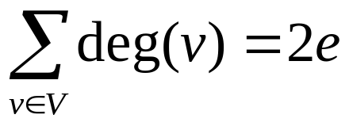
10.2 Graph Terminology and Special Types of Graphs
【 Theorem 1】 The Handshaking Theorem
Let G = (V, E) be an undirected graph with e edges. Then
The sum of the degrees over all the vertices is twice the number of edges.
Proof:
Each edge contributes twice to the degree count of all vertices.
Note:
This applies even if multiple edges and loops are present.

Slide 15
10.2 Graph Terminology and Special Types of Graphs
Qusetions:
If a graph has 5 vertices, can each vertex have degree 3? 4?
  The sum is 3•5 = 15 which is an odd number.
  Not possible.
  The sum is 20 = 2 | E | and 20/2 = 10.
  Possible.

Slide 16

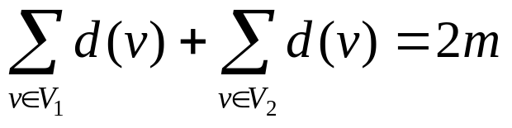
10.2 Graph Terminology and Special Types of Graphs
【 Theorem 2】 An undirected graph has an even number of
vertices of odd degree.
Proof:
Let be the set of vertices of even degree and the set of vertices of odd degree, respectively.
Qusetion:
Is it possible to have a graph with 3 vertices each of which has degree 3?

Slide 17
10.2 Graph Terminology and Special Types of Graphs
a
Directed Graphs G=(V, E)
d
b
e
c
Let (u, v) be an edge in G. Then u is an initial vertex and is adjacent to v and v is a terminal vertex and is adjacent from u.
The in degree of a vertex v, denoted deg⁻(v) is the number of edges which terminate at v.
Similarly, the out degree of v, denoted deg⁺(v), is the number of edges which initiate at v.
underlying undirected graph

Slide 18
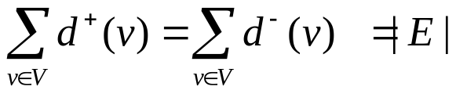
10.2 Graph Terminology and Special Types of Graphs
【 Theorem 3】 Let G = (V, E) be a graph with direct edges.
Then

Slide 19
10.2 Graph Terminology and Special Types of Graphs
2. Some Special Simple Graphs
(1) Complete Graphs - K_{n}: the simple graph with
  - n vertices
  - exactly one edge between every pair of distinct vertices.
The graphs K_{n} for n=1,2,3,4,5.
K₁
K₂
K₃
K₄
K₅
Qusetion:
The number of edges in K_{n} ?

Slide 20
10.2 Graph Terminology and Special Types of Graphs
(2) Cycles C_{n} (n>2)
C₃
C₄
C₅
C₆

Slide 21
10.2 Graph Terminology and Special Types of Graphs
(3) Wheels W_{n} (n>2)
Add one additional vertex to the cycle C_{n} and add an edge from each vertex in C_{n} to the new vertex to produce W_{n}.
W₃
W₄
W₅
W₆

Slide 22
10.2 Graph Terminology and Special Types of Graphs
(4) n-Cubes Q_{n} (n>0)
Q_{n} is the graph with 2^{n} vertices representing bit strings of length n. An edge exists between two vertices that differ in exactly one bit position.
110
111
10
11
100
101
010
011
0
1
00
01
000
001
Q₁
Q₂
Q₃

Slide 23
10.2 Graph Terminology and Special Types of Graphs
3. Bipartite Graphs
A simple graph G is bipartite if V can be partitioned into two disjoint subsets V₁ and V₂ such that every edge connects a vertex in V₁ and a vertex in V₂.
Note:
There are no edges which connect vertices in V₁ or in V₂.
For example,
v₁
v₂
v₃
v₅
v₄

Slide 24
10.2 Graph Terminology and Special Types of Graphs
〖Example 1〗 Is C₃ bipartite?
v₁
v₂
v₃
No.

Slide 25
10.2 Graph Terminology and Special Types of Graphs
〖Example 2〗 Is C₆ bipartite?
v₁
v₆
v₂
v₅
v₃
v₄
Yes. Because we can display C₆ like this:
v₁
v₆
v₅
v₂
v₃
v₄

Slide 26
10.2 Graph Terminology and Special Types of Graphs
The complete bipartite graph is the simple graph that has its vertex
set partitioned into two subsets V₁ and V₂ with m and n vertices,
respectively, and every vertex in V₁ is connected to every vertex in
V₂, denoted by K_{m,n}, where m = | V₁ | and n = | V₂ |.
For example,
A Star network is a K_{1,n}
(2) K_{3,2}

Slide 27
10.2 Graph Terminology and Special Types of Graphs
【 Theorem 4】 A simple graph is bipartite if and only if it is
possible to assign one of two different colors to each vertex
of the graph so that no two adjacent vertices are assigned the
same color.
Proof:
Suppose that G=(V, E) is a bipartite simple graph. Then V=V₁∪V₂,where V₁,V₂ are disjoint sets and every edge in E connects a vertex in V₁ and a vertex in V₂ .
Suppose that it is possible to assign colors to the vertices of the graph using just two colors so that no two adjacent vertices are assigned the same color.

Slide 28

10.2 Graph Terminology and Special Types of Graphs
Regular graph
A simply graph is called regular if every vertex of this graph has the same degree.
A regular graph is called n-regular if every vertex in this graph has degree n.
For example,
(1) is a (n-1)-regular.
(2) For which values of m and n is K_{m,n} regular?

Slide 29
10.2 Graph Terminology and Special Types of Graphs
4. Some applications of special types of graphs
〖Example 3〗 Local Area Networks.
Star topology
Ring topology
Hybrid topology

Slide 30


10.2 Graph Terminology and Special Types of Graphs
5. New Graphs from Old
【Definition】 G= (V, E) , H= (W, F)
H is a subgraph of G if .
subgraph H is a proper subgraph of G if H≠G.
H is a spanning subgraph of G if .
For example,
subgraph of K₅
K₅

Slide 31
10.2 Graph Terminology and Special Types of Graphs
〖Example 4〗 How many subgraphs with at least one vertex does W₃ have?
Solution:

Slide 32
10.2 Graph Terminology and Special Types of Graphs
The union of G₁and G₂
The union of two simple graphs G₁ = ( V₁ , E₁ ) and G₂ = ( V₂ , E₂ ) is the simple graph with vertex set V = V₁ ∪ V₂ and edge set E = E₁ ∪ E₂ .
Notation: G₁ ∪ G₂
For example,
e
e
a
d
a
d
a
d
b
c
b
c
b
c
G₁
G₂
G₁ ∪ G₂ = K₅

Slide 33
876Homework: (Due on May 16)
Sec. 10.1 1, 3-9
Sec. 10.2 5, 24, 25, 44(b, f, h), 55, 62

Slide 34
CHAPTER 10 Graphs
10.1 Graphs and Graph Models
10.2 Graph Terminology and Special Types of Graphs
10.3 Representing Graphs and Graph Isomorphism
10.4 Connectivity
10.5 Euler and Hamilton Paths
10.6 Shortest Path Problems
10.7 Planar Graphs
10.8 Graph Coloring

Slide 35
10.3 Representing Graphs and Graph Isomorphism
1. Representing Graphs
Methods for representing graphs:
  Graphs
  Adjacency lists
  -- lists that specify all the vertices that are adjacent to each vertex
  Adjacency matrices
  Incidence matrices
An adjacency list for a directed graph
Initial vertex | terminal vertices
a b c d e | b,c,d,e b,d a,c,e b,c,d
An adjacency list for a simple graph
vertex | Adjacent vertices
a b c d e | b,c,e a a,d,e c,e a,c,d

Slide 36

10.3 Representing Graphs and Graph Isomorphism
2. Adjacency Matrices
A simple graph G = (V, E) with n vertices ( ) can be represented by its adjacency matrix, A, with respect to this listing of the vertices, where
a_{ij} = 1 if {v_{i}, v_{j}} is an edge of G,
a_{ij} = 0 otherwise.
Note: An adjacency matrix of a graph is based on the ordering chosen for the vertices.

Slide 37
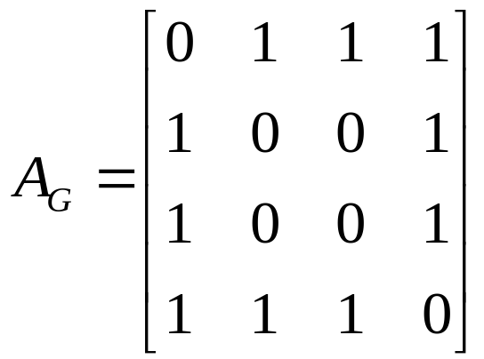
10.3 Representing Graphs and Graph Isomorphism
Note: Adjacency matrices of undirected graphs are always symmetric.
〖Example 1〗 What is the adjacency matrix A_{G} for the following graph G based on the order of vertices a, b, c, d ?
a
Solution:
b
d
c

Slide 38
10.3 Representing Graphs and Graph Isomorphism
  The adjacency matrix of a multigraph or pseudograph
For the representation of graphs with multiple edges, we can no longer use zero-one matrices.
Instead, we use matrices of nonnegative integers.
The (i, j)th entry of such a matrix equals the number of edges that are associated to {v_{i}, v_{j}}.

Slide 39
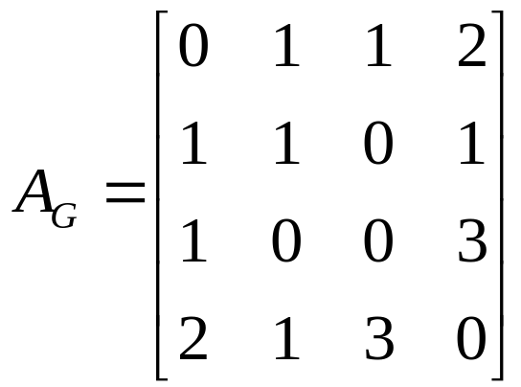
10.3 Representing Graphs and Graph Isomorphism
〖Example 2〗 What is the adjacency matrix A_{G} for the following graph G based on the order of vertices a, b, c, d ?
a
Note: For undirected multigraph or pseudograph , adjacency matrices are symmetric.
b
d
c
Solution:

Slide 40
10.3 Representing Graphs and Graph Isomorphism
  The adjacency matrix of a directed graph
Let G = (V, E) be a directed graph with |V| = n. Suppose that the vertices of G are listed in an arbitrary order as v₁, v₂, …, v_{n}.
The adjacency matrix A (or A_{G}) of G, with respect to this listing of the vertices, is the n×n zero-one matrix with 1 as its (i, j)th entry when there is an edge from v_{i} to v_{j}, and 0 otherwise.
In other words, for an adjacency matrix A = [a_{ij}],
a_{ij} = 1 if (v_{i}, v_{j}) is an edge of G,
a_{ij} = 0 otherwise.

Slide 41
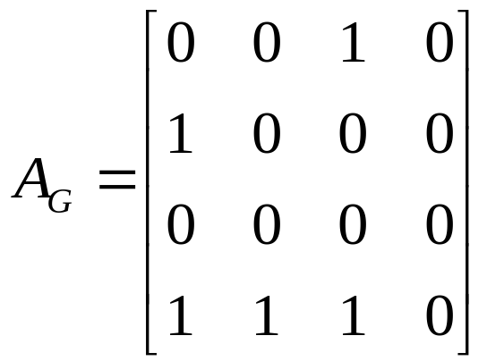
10.3 Representing Graphs and Graph Isomorphism
〖Example 3〗 What is the adjacency matrix A_{G} for the following graph G based on the order of vertices a, b, c, d ?
a
b
d
c
Solution:

Slide 42
10.3 Representing Graphs and Graph Isomorphism
Question:
What is the sum of the entries in a row of the adjacency matrix for an undirected graph?
a
b
d
c

Slide 43
10.3 Representing Graphs and Graph Isomorphism
Question:
What is the sum of the entries in a row of the adjacency matrix for an undirected graph?
The number of edges incident to the vertex i, which is the same as degree of i minus the number of loops at i.
For a directed graph?
a
b
d
c

Slide 44
10.3 Representing Graphs and Graph Isomorphism
Question:
What is the sum of the entries in a row of the adjacency matrix for an undirected graph?
The number of edges incident to the vertex i, which is the same as degree of i minus the number of loops at i.
For a directed graph?
deg⁺(v_{i})
What is the sum of the entries in a column of the adjacency matrix for an undirected graph?
The number of edges incident to the vertex i, which is the same as degree of i minus the number of loops at i.
For a directed graph?
deg⁻(v_{i})

Slide 45


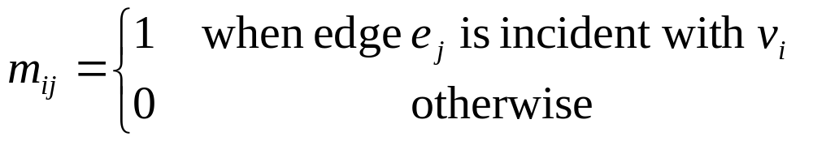
10.3 Representing Graphs and Graph Isomorphism
3. Incidence matrices
Let G = (V, E) be an undirected graph. Suppose that
are the vertices and are the edges of G. Then the incidence matrix with respect to this ordering of V and E is n×m matrix , where

Slide 46
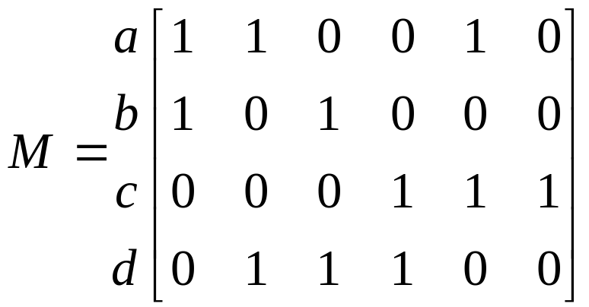
9.3 Representing Graphs and Graph Isomorphism
〖Example 4〗 What is the incidence matrix M for the following graph G based on the order of vertices a, b, c, d and edges 1, 2, 3, 4, 5, 6?
a
1
2
b
d
3
5
4
c
Solution:
6
Note:
Incidence matrices of undirected graphs contain two 1s per column for edges connecting two distinct vertices and one 1 per column for loops.

Slide 47
10.3 Representing Graphs and Graph Isomorphism
4. Isomorphism of Graphs
Graphs with the same structure are said to be isomorphic.
Formally, two simple graphs G₁= (V₁, E₁) and G₂= (V₂, E₂) are isomorphic if there is a 1-1 and onto function f from V₁ to V₂ such that for all a and b in V₁, a and b are adjacent in G₁ iff f(a) and f(b) are adjacent in G₂.
Such a function f is called an isomorphism.
In other words, when two simple graphs are isomorphic, there is a one-to-one correspondence between vertices of the two graphs that preserves the adjacency relationship.

Slide 48
10.3 Representing Graphs and Graph Isomorphism
For example,
a
a' (b)
b
d‘(d)
d
c
c' (a)
b' (c)

Slide 49
10.3 Representing Graphs and Graph Isomorphism
Question:
How to determine whether two simple graphs are isomorphic?
It is usually difficult since there are n! possible 1-1 correspondence between the two vertex sets with n vertices. However, some properties (called invariants) in the graphs may be used to show that they are not isomorphic.
invariants
-- things that G₁ and G₂ must have in common to be isomorphic.

Slide 50
10.3 Representing Graphs and Graph Isomorphism
Important invariants in isomorphic graphs:
  the number of vertices
  the number of edges
  the degrees of corresponding vertices
  if one is bipartite, the other must be
  if one is complete, the other must be
  if one is a wheel, the other must be
  etc.

Slide 51
10.3 Representing Graphs and Graph Isomorphism
〖Example 5〗 Are the following two graphs isomorphic?
a
a
b
e
e
b
c
d
c
d
Solution:
They are isomorphic, because they can be arranged to look identical.
You can see this if in the right graph you move vertex b to the left of the edge {a, c}. Then the isomorphism f from the left to the right graph is:
f(a) = e, f(b) = a,
f(c) = b, f(d) = c, f(e) = d.

Slide 52
10.3 Representing Graphs and Graph Isomorphism
〖Example 6〗 Show that the following two graphs are isomorphic.
u₁
u₂
v₁
v₂
u₅
v₅
v₃
u₃
v₄
u₄
Proof:
Try to find an 1-1 and onto function f
Show that f isomorphism (preserves adjacency relation)
- The adjacency matrix of a graph G is the same as the adjacency matrix of another graph H, when rows and columns are labeled to correspond to the images under f of the vertices in G that are the labels of these rows and columns in the M_{G}

Slide 53
10.3 Representing Graphs and Graph Isomorphism
〖Example 7〗 Determine whether the given pair of graphs is isomorphic?
(1)
(2)
(3)

Slide 54
Homework: (Due on May 16)
Sec. 10.3 8, 15, 17, 34-37

